Slide 1
A Better South Africa
Catholic Schools / 12 September 2017

Slide 2
Presentation for…..

Slide 3
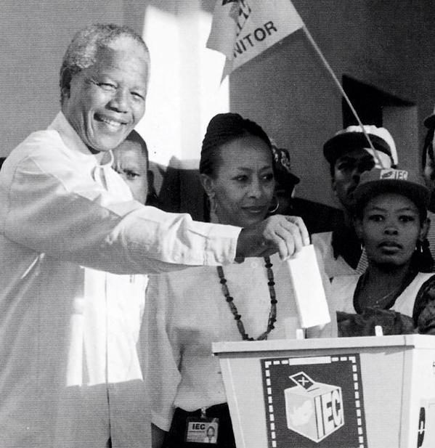
Current Situation
We need to recapture the dream that started in 1994.
This dream enabled us to leap across huge chasms of angry divides to build a new society.

Slide 4
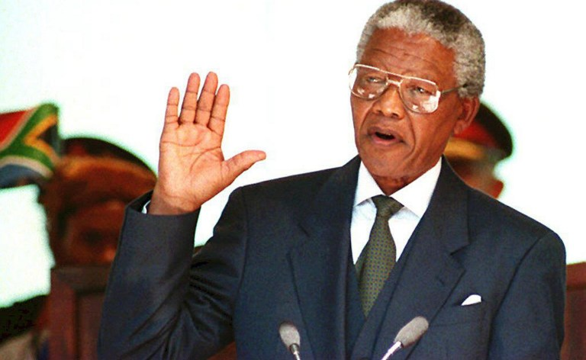
Current Situation
We embraced the African wisdom embedded in uBuntu and committed to reconnect with one another to be united in our diversity.

Slide 5
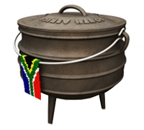
Our “Potjie”
1. It’s used and understood by every culture in SA.
2. It has three legs for a very good reason
3.The problem is our potjie can’t stand properly as it’s only got one leg

Slide 6
The RiSA “Trilogy”
THE THREE LEGGED POTJIE
We need to complement our celebrated Political Settlement with an Emotional Settlement (healing and the establishment of new values – human rights, rule of law and social justice) and a Socio-economic Settlement (transforming structural inequalities and promoting inclusive sustainable socio-economic systems).

Slide 7
Our Focus
Our key focal entry point is transforming education and training.
These foundations for nurturing and development of talent are seriously under-performing and driving the persistent poverty, inequality and unemployment.
The outcomes we seek are 21st century critical thinkers, innovators and responsible shapers of the future.

Slide 8
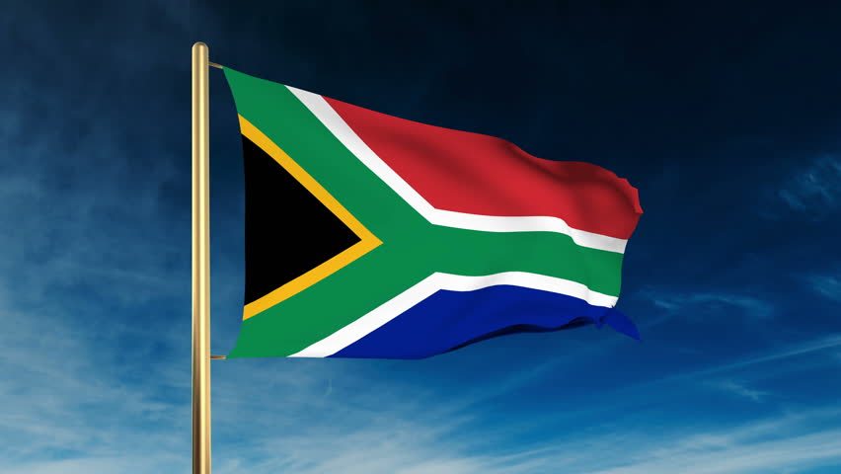
Our Mandate

Slide 9
Our Constitution
1. It’s ours and it belongs to all of us
2. Not only does it show us our rights it also teaches us our responsibilities.
3. It has the potential to unite us as one people.
4. Why have we failed to embrace it when it belongs to us?

Slide 10
Our Constitution
SUBHEADING / DESCRIPTION

Slide 11
Our Target Market
Children and young people are our key target segment given that they are by far the largest segment in our society, and most amenable to mindset change.
Over and above this we will also work with the principals, teachers and parents
Our goal is to work with Business, Education, Faith based communities and Civil Society as a whole.

Slide 12
Our “Nectopus”
The Federation of School Governing Bodies of South Africa (FEDSAS)
Catholic and Anglican Schools
Southern African Heads of Independent Schools (SAHISA)
Independent Schools Association of Southern Africa (ISASA);
LEAP Schools
Extraordinary Schools Network (ESN)

Slide 13
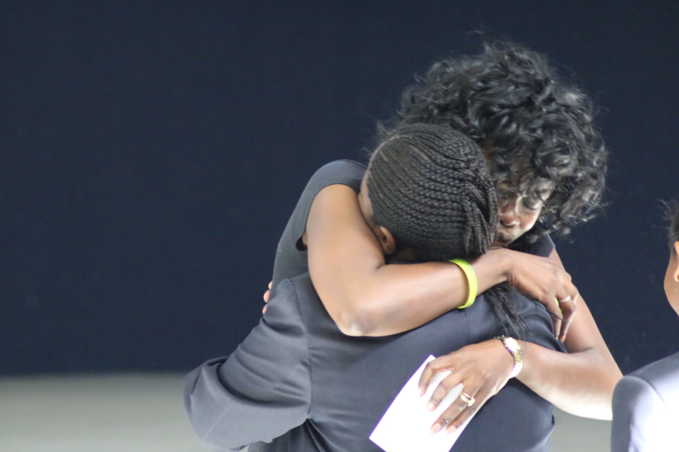
Our How
We train youth coaches (20-30 years of age) to work in schools. These youth coaches are living examples of what we teach.
They live out (model) the values that we teach.
They are seen as role models.

Slide 14
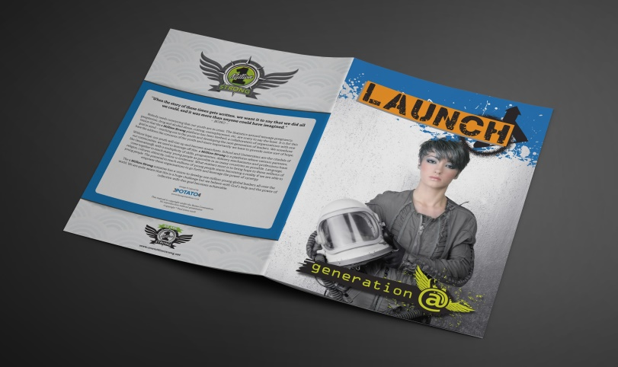
Our Programme

Slide 15
Programme Content
Module # 1: Personal Responsibly
Module # 2: Personal Deception
Module # 3: Personal Transformation
Module # 4: Personal Development
Module # 5: Personal Integrity
Module # 6: Creating a “reimagined” South Africa
Module # 7: Developing new paradigms that drive change
Module # 8: What is democratic Governance?
Module # 9: The importance of our Constitution
Module # 10: An Emotional Settlement
Module # 11: We are faced with five choices
Module # 12: Personal Commitments and Boundaries

Slide 16
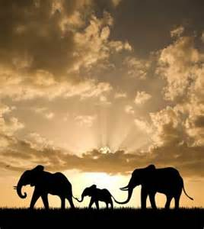
Our Partners
One Million Strong
MAD Leadership Programme
UnlockD
Father A Nation (FAN).
South African Association of
Youth Clubs (SAAYC)

Slide 17
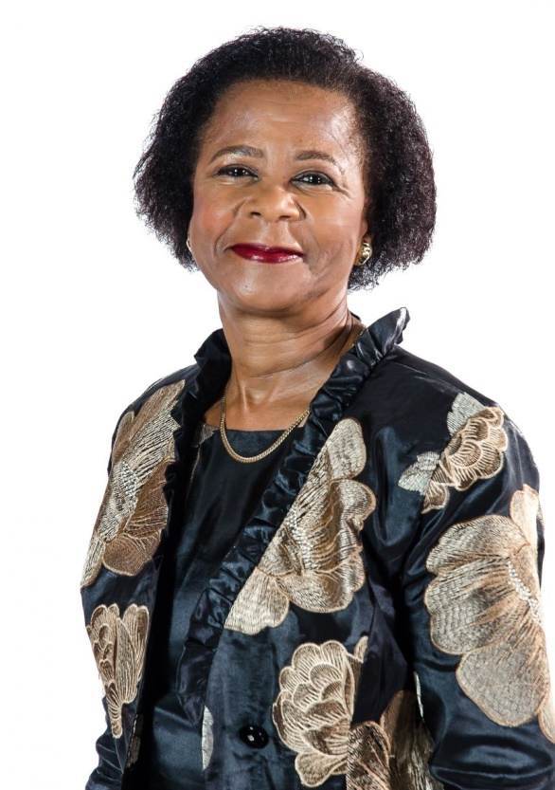
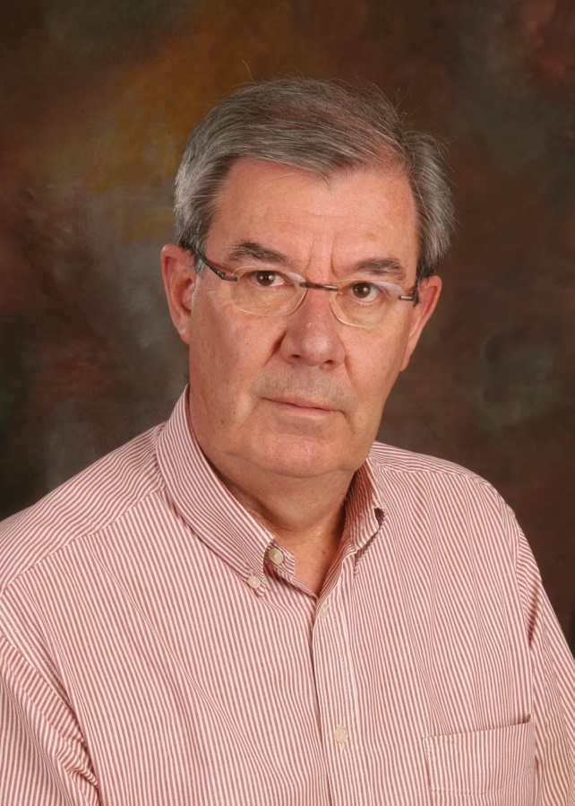
Our Founders
Dr. Mamphela Ramphele
Dr. George Lindeque

Slide 18
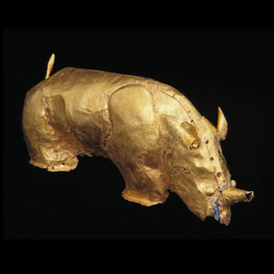
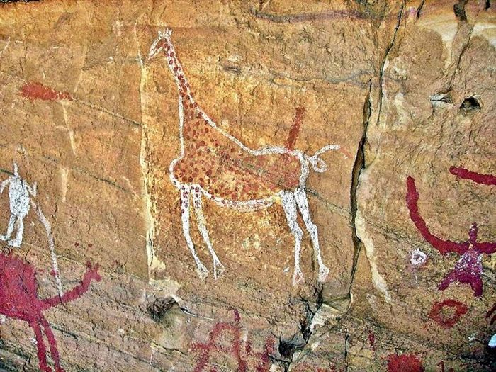
Academic Stream
Mother tongue teaching and learning at Foundation level
Revival of African Languages as subjects and carriers of culture
LO as a vehicle of Values Based Civic Education
African History to be taught from antiquity not 1652
Unleash the power of Heritage of the cradle of humanity

Slide 19
Where to From Here?
Institutional Leadership to constitute a Transformation Team (TT) and work with Facilitators to start the journey
TT to Reimagine Institution
TT identifies obstacles to a Reimagined Institutional framework becoming reality
TT to tell one another their “stories” which will initiate healing conversations that address obstacles
The process always starts with self
TT to agree a process and timelines
TT identify internal facilitation team to be trained.
The Institutional accepts responsibility to drive the transformation process (ownership)

Slide 20
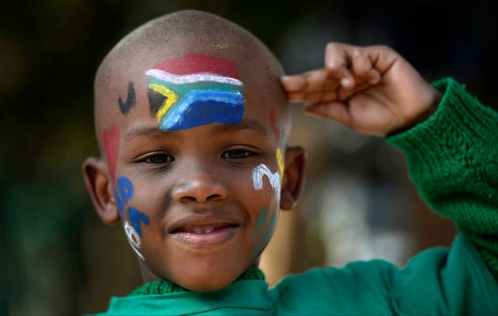
Thank You

